Slide 1
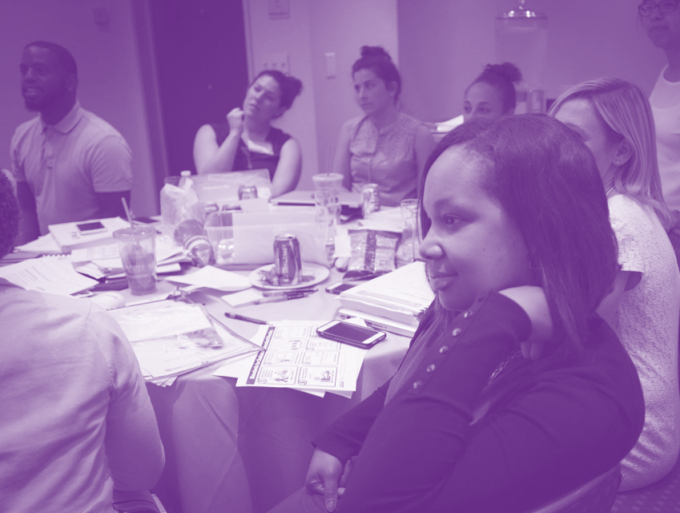
Session 3:
How does Bias Manifest in our School?
Except where otherwise indicated, all content is © 2016 UnboundEd Learning, Inc. www.unbounded.org
Notes:
PLEASE NOTE: This seven-step framework is adapted from © Case Studies on Diversity and Social Justice Education by Paul C. Gorski and Seema G. Pothini, 2018.

Slide 2
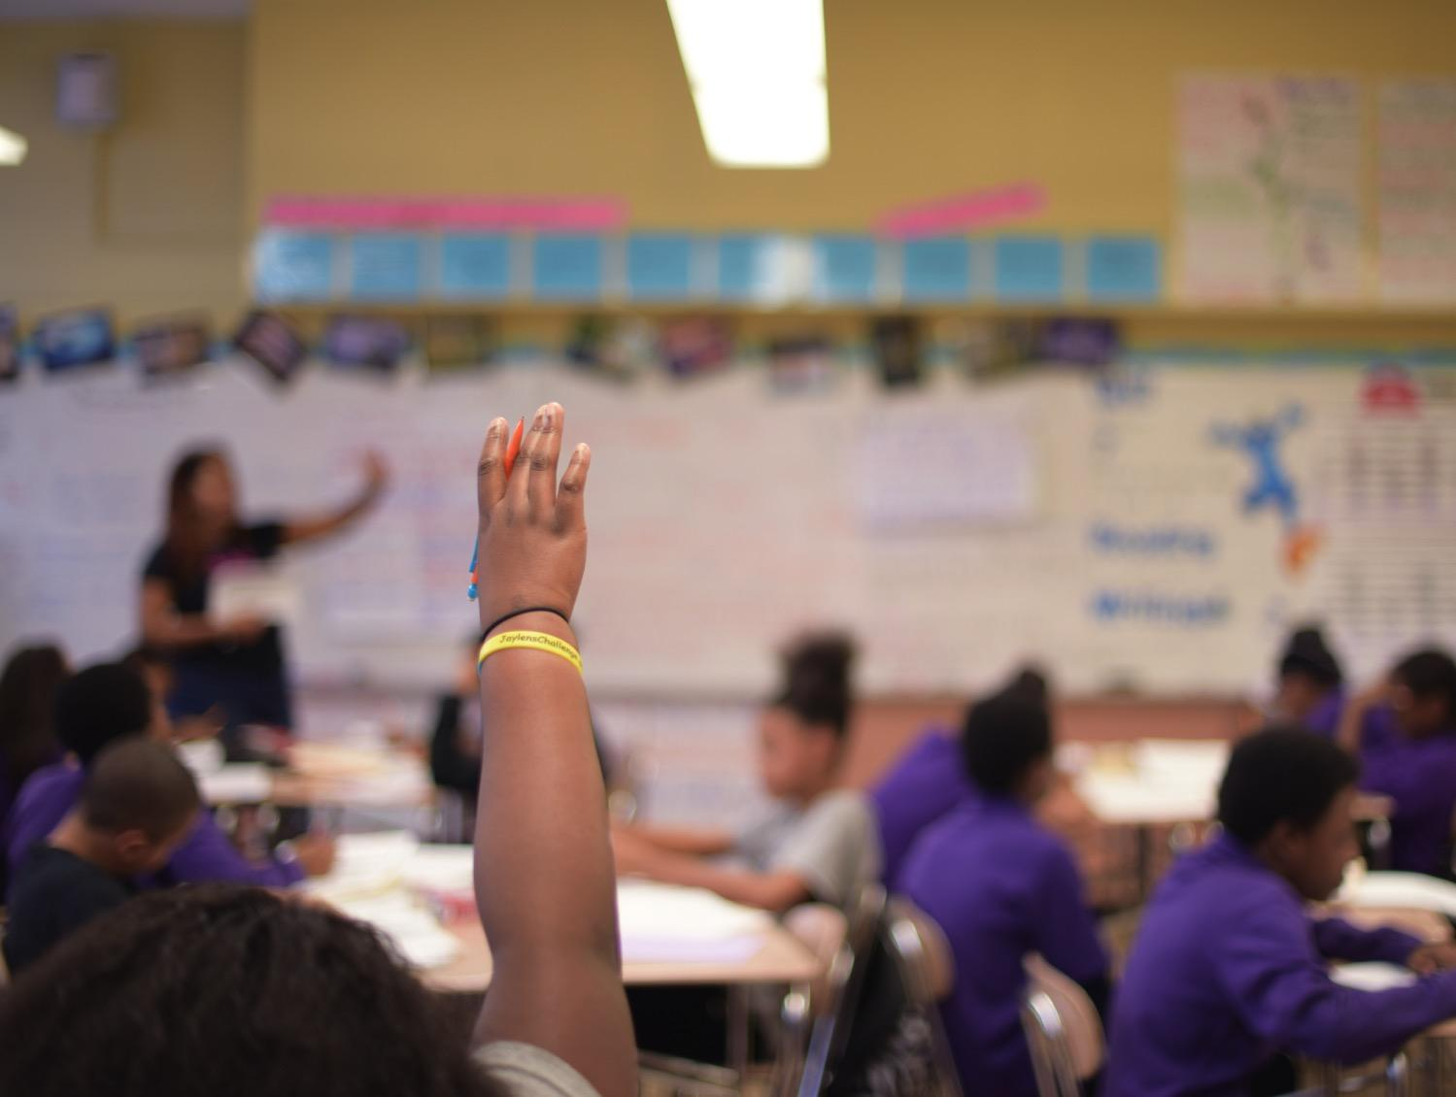
Group Norms for Our Discussion
Be willing to surface and explore unconscious beliefs and values.
Listen to hear, not respond.
Be mindful that your truth can be different for others.
Honor confidentiality.
Take responsibility for your own learning.
Be willing to think about situations and issues with a new or expanded perspective.
Notes:
Facilitator Notes: It is very important to carefully set up this conversation and have group norms that the group creates or agrees to. Here are some suggested norms.

Slide 3
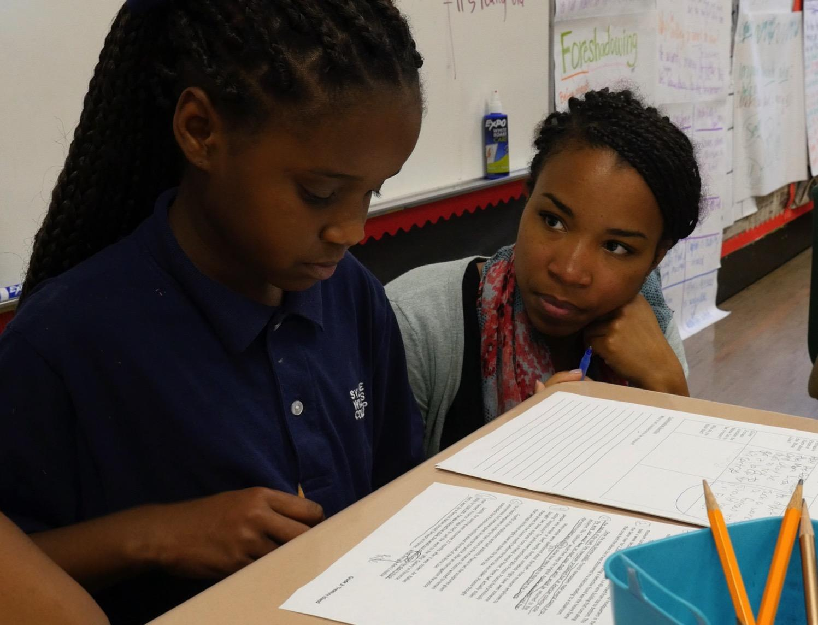
Set the Context
TBD
Notes:
Facilitator Notes: This slide is set aside for you to annotate the bias conversation. It is helpful to include any relevant data or notes that you have about your school. This is simply a framing slide and should require no more than 5 mins.

Slide 4
Case Study
After reading the case study, we’ll work through the following protocol to examine it.
Step 1) Identify the problem or problems posed by the case study
Step 2) Take stock of the different perspectives
Step 3) Consider possible barriers and opportunities
Step 4) Imagine equitable outcomes
Step 5) Brainstorm a list of immediate-term responses
Step 6) Brainstorm long-term policy and practice adjustments
Step 7) Propose your plan of action
Notes:
Facilitator Notes: Prior to this session, reflect on the case studies from Session 1 and Session 2. Work with a few colleagues to identify a real incident or moment from your school that would work as a good case study for the entire group. Write and print it before the session so that participants can read it during this time.
After the participants read the case study from your own school, discuss the case study itself and then expand it more broadly to identify what, where, and when biases may be a barrier to progress at your school.
You may want to use these three questions to start the conversations:
Looking at your student data by race, what analyses can you make about disproportionality of achievement or discipline that is predictable by grade band or gender?
Give or cite a specific example or scenario that magnifies the disproportionate data
What was the response by members of the community to the example or scenario cited?
As a team, review the case scenario as is and use the seven-step protocol as we have before to unpack and analyze an equitable resolution.

Slide 5
Who Am I?
Complete the sentence, “I am…” using as many descriptors as you can think of in sixty seconds.
I am ____________________________________.
I am ____________________________________.
I am ____________________________________.
I am ____________________________________.
I am ____________________________________.
I am ____________________________________.
I am ____________________________________.
Notes:
Facilitator Notes: Ask the participants - If you had to ask your students who they are, what type of “I am…” statements do you think they would make?

Slide 6
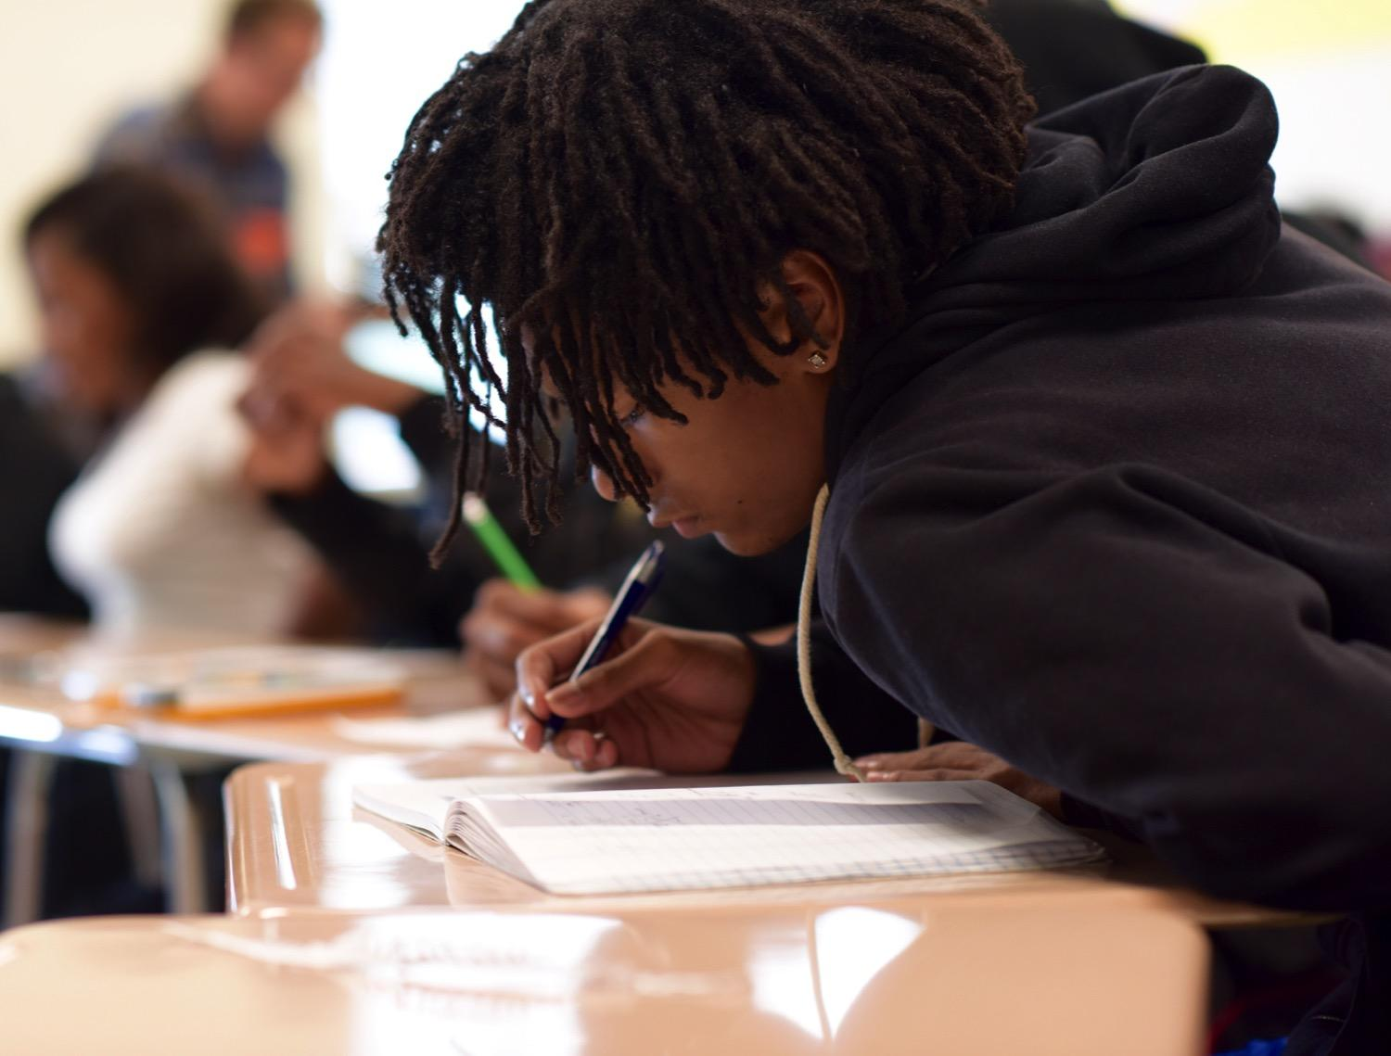
“When I do not know myself, I cannot
know who my students are. I will see
them through a glass darkly in the
shadows of my unexamined life –
And when I cannot see them clearly,
I cannot teach them well”
–Parker Palmer
Notes:
Facilitator Notes:

Slide 7
Pre-work: “Equity: Literacy for All”
What’d you think about the article?
Notes:
Facilitator Notes: Facilitate

Slide 8
Hearing this information makes me think…
What are the implications for me in my role at my school/work?
Developing a Culturally Competent School
reflections on my role
Challenges I face with respect to cultural differences is…
Therefore, I will…
By participating in this conversation today, I’ve changed my thinking about…
Notes:
Facilitator Notes:

Slide 9
Factors of Diversity (MSDE)
Gender
Religion
Region
Age
Race/Ethnicity
Language
Socio-Economic Class
Disability
Notes:
Facilitator Notes:

Slide 10
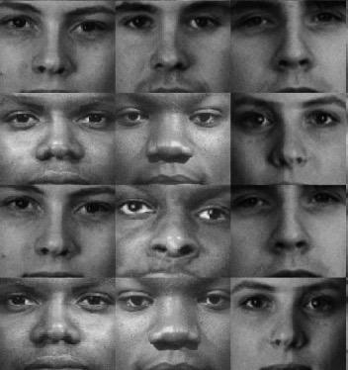
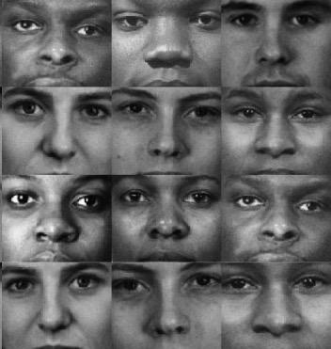
Some Patterns of Aspects and Assumptions in Mainstream U.S. American Culture
Holidays Religion Communication Rugged Individualism Protestant Work Ethic Competition | Aesthetics Competition Time Family Structure History
Notes:
Facilitator Notes:

Slide 11
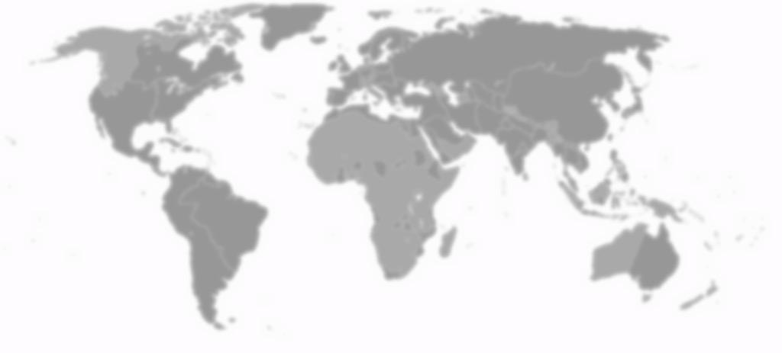
100 People: A World Portrait Cont.
60 Asians
10 Europeans
14 people from the Americas
16 Africans
25 Children
75 Adults
50 Female
50 Male
31 Christians
23 Muslims
15 Hindus
7 Buddhists
8 who practice other religions
16 who would not be aligned with a religion
70 Non-white
30 White
Notes:
Facilitator Notes: If the world consisted of just 100 people, this is what it would look like based on global data from 2016.
Source: http://100people.org/
Sources: 2016 - Fritz Erickson, Provost and Vice President for Academic Affairs, Ferris State University (Formerly Dean of Professional and Graduate Studies, University of Wisconsin - Green Bay) and John A. Vonk, University of Northern Colorado, 2006; Returning Peace Corps Volunteers of Madison Wisconsin, Unheard Voices: Celebrating Cultures from the Developing World, 1992; Donella H. Meadows, The Global Citizen, May 31, 1990.

Slide 12
100 People: A World Portrait Cont.
86 would be able to read and write; 14 would not
7 would have a college degree
40 would have an internet connection
78 would have a place to shelter them from the wind and the rain, but 22 would not
1 would be dying of starvation
11 would be undernourished
22 would be overweight
Notes:
Facilitator Notes: If the world consisted of just 100 people, this is what it would look like based on global data from 2016.
Source: http://100people.org/

Slide 13
We Only See the Tip of the Iceberg
Explicit
Culture
Arts
Food
Dress
Music
Notions of Modesty
Rules of Descent
Relationship to Animals
Notions of Leadership
Approach to Conflict Resolution
Nonverbal Language
Patterns of Expression of Emotion
Incentives to Work
Concept of Beauty
Ideals for Child Rearing
Concept of Justice
Concept of Cleanliness
Concept of Time
Concept of “Self”
Nature of Friendship
Definition of Family
Implicit
Culture

Slide 14
When Two Icebergs Meet: Cultural Clash
V
I
S
I
B
L
E
Behavior
Behavior
Artifacts
Artifacts
Practices
Practices
Values
Values
I
N
V
I
S
I
B
L
E
Beliefs
Beliefs
Norms
Norms
Universal Human Needs
Universal Human Needs
Notes:
Facilitator Notes:

Slide 15
How do we Develop Lenses?
Legacies + Layers = Lenses
Notes:
Facilitator Notes: We all see the world through certain lenses, and this is how our lenses are formed.

Slide 16
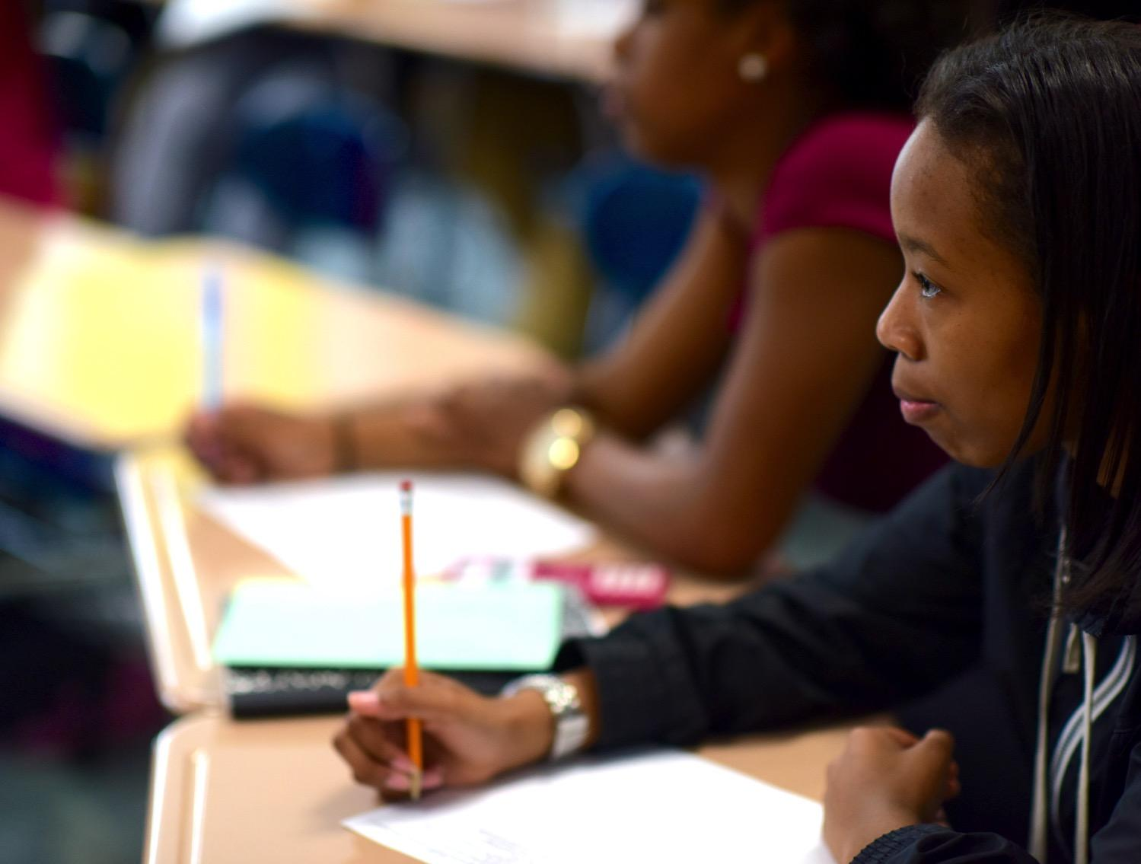
1. Assimilationist Lens
MOTTO: “When in Rome, do as the Romans do.”
BELIEF SYSTEM:
Immigrants and other subcultures should adopt the lifestyle, values, customs, and language of the majority culture.
Want individuals to submerge their cultural identities in favor of nationalistic and patriotic ideals. The primary allegiance should be to the unity and welfare of the nation.
Notes:
Facilitator Notes: Explain the Assimilationist Lens to the group
Source: Mark A. Williams, The 10 Lenses: Your Guide to Living & Working in a Multicultural World: 2001, Capital Books, Inc.

Slide 17
1. Assimilationist Lens Cont.
ISSUES:
Curb immigration
Use of the English language
Ethnocentric curricula
Minimize/misunderstand the impact of race, ethnicity, and culture have in American society
Melting pot theory
Notes:
Facilitator Notes: Explain the Assimilationist Lens to the group
Source: Mark A. Williams, The 10 Lenses: Your Guide to Living & Working in a Multicultural World: 2001, Capital Books, Inc.

Slide 18
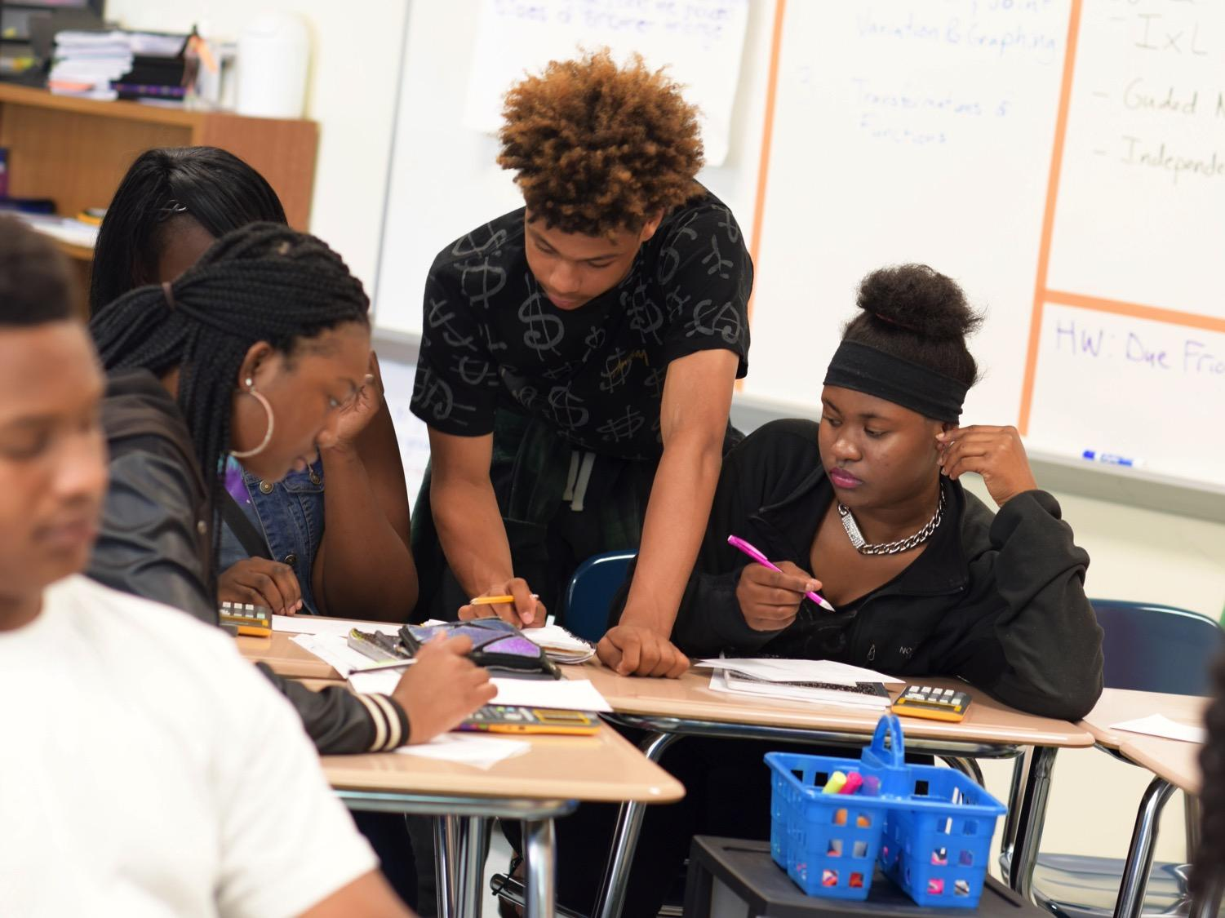
Assimilationist Lens Discussion
Turn and talk with a partner
Notes:
Facilitator Notes: Ask participants to talk about this lens with a partner. As the group discusses, walk around and pick a few that you can highlight with the entire group before moving on to the next section.

Slide 19
2. Colorblind Lens
MOTTO: “When I see you, I see a person, not your color.”
BELIEF SYSTEM:
All men and women are created equal.
Want to look at a person’s individual qualities and character
Believe that ignoring race and color will have an equalizing effect.
Notes:
Facilitator Notes: Explain the Colorblind Lens to the group
Source: Mark A. Williams, The 10 Lenses: Your Guide to Living & Working in a Multicultural World: 2001, Capital Books, Inc.

Slide 20
2. Colorblind Lens Cont.
STRENGTHS:
Recognize and value each person’s individuality
See each new interaction as an opportunity to begin a positive relationship
Do not rely on stereotypes from the society at large
Help build inclusive organizations
Notes:
Facilitator Notes: Explain the Colorblind Lens to the group
Source: Mark A. Williams, The 10 Lenses: Your Guide to Living & Working in a Multicultural World: 2001, Capital Books, Inc.

Slide 21
2. Colorblind Lens Cont.
ISSUES:
Deny what is often central to an individual’s identity
Often miss evidence of institutionalized racism
May overlook or be unaware of just how much race, color, ethnicity, and nationality determine where people live and go to school: whom they vote for, marry, do business and socialize with; activities in which they participate
Notes:
Facilitator Notes: Explain the Colorblind Lens to the group
Source: Mark A. Williams, The 10 Lenses: Your Guide to Living & Working in a Multicultural World: 2001, Capital Books, Inc.

Slide 22
Colorblind Lens Discussion
Turn and talk with a partner
Notes:
Facilitator Notes: Ask participants to talk about this lens with a partner. As the group discusses, walk around and pick a few that you can highlight with the entire group before moving on to the next section.

Slide 23
3. Meritocratist Lens
MOTTO: “Cream rises to the top.”
BELIEF SYSTEM:
Opportunity should be based only on an individual’s initiative, competence, and accomplishment.
If you have the abilities and work hard enough, you can compete with anyone to make your dreams come true.
Notes:
Facilitator Notes: Explain the Meritocratist Lens to the group
Source: Mark A. Williams, The 10 Lenses: Your Guide to Living & Working in a Multicultural World: 2001, Capital Books, Inc.

Slide 24
3. Meritocratist Lens Cont.
STRENGTHS:
self-reliant and strong individualists advocate for high standards of excellence believe every person counts
ISSUES:
Unaware of the ways that organizational culture and
infrastructure create barriers for certain groups based
on their lack of fit with the predominant culture
Focus on the individual to overcome barriers rather than acknowledge systems of inequities
Notes:
Facilitator Notes: Explain the Meritocratist Lens to the group
Source: Mark A. Williams, The 10 Lenses: Your Guide to Living & Working in a Multicultural World: 2001, Capital Books, Inc.

Slide 25
Meritocratist Lens Discussion
Turn and talk with a partner
Notes:
Facilitator Notes: Ask participants to talk about this lens with a partner. As the group discusses, walk around and pick a few that you can highlight with the entire group before moving on to the next section.

Slide 26
Lense Processing
1. How are the 3 lenses embedded within the educational system?
2. How do these lenses show up in our school?

Slide 27
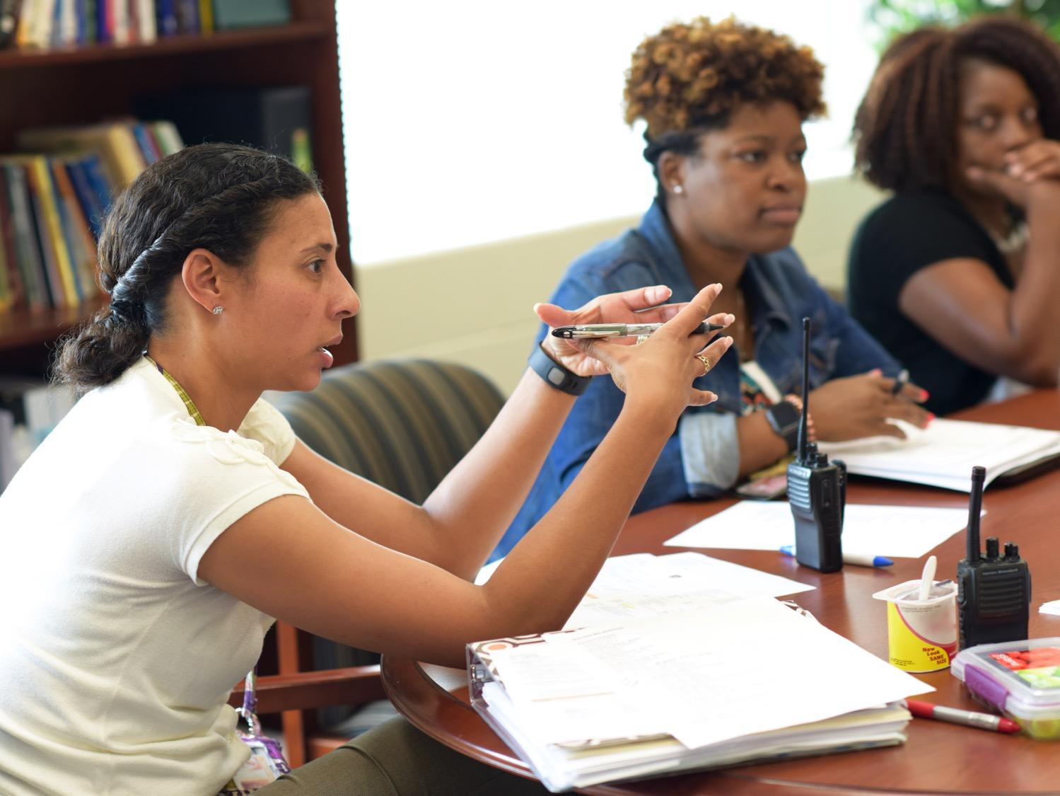
What did
you learn?
Notes:
Facilitator notes: Talk with your group and asked them what they have learned by reading the article and case study in this session.

Slide 28
How does bias manifest in our school?
Notes:
Facilitator notes: Take the discussion from the previous slide and bring it home. How does this conversation specifically relate to your school? What trends do you see? This is also a good time to discuss suspension records, grade data, attendance records, etc. as they pertain to bias.

Slide 29
Who am I?
Where do we go from here?
Notes:
Facilitator notes: Work with the group to determine next steps for your school. Consider guiding the group by asking what your school needs to pull apart and analyze as well as actionable steps that you can take to improve the school’s environment.

Slide 30
Thank You
Notes:
Facilitator Notes: Thank all of the participants for being open and vulnerable during the discussion today.

