Slide 1



Session 2:
Historical Perspective About Race in America
Except where otherwise indicated, all content is © 2016 UnboundEd Learning, Inc. www.unbounded.org
Notes:
PLEASE NOTE: This seven-step framework is adapted from © Case Studies on Diversity and Social Justice Education by Paul C. Gorski and Seema G. Pothini, 2018.

Slide 2

Conversations about race and privilege will never be perfect, or easy, but there is a beauty in understanding that they can teach you just as much, if not more, than you can teach them.
Notes:
Facilitator Notes: Ask the group to read this silently and reflect on it before beginning.
Source: This quote was pulled from “Teaching While White” http://www.tolerance.org/blog/teaching-while-white

Slide 3

Group Norms for Our Discussion
Be willing to surface and explore unconscious beliefs and values.
Listen to hear, not respond.
Be mindful that your truth can be different for others.
Honor confidentiality.
Take responsibility for your own learning.
Be willing to think about situations and issues with a new or expanded perspective.
Notes:
Facilitator Notes: It is very important to carefully set up this conversation and have group norms that the group creates or agrees to. Here are some suggested norms.

Slide 4
Set the Context
TBD
Notes:
Facilitator Notes: This slide is set aside for you to annotate the bias conversation. It is helpful to include any relevant data or notes that you have about your school. This is simply a framing slide and should require no more than 5 mins.

Slide 5

Case Study
After reading the case study, we’ll work through the following protocol to examine it.
Step 1) Identify the problem or problems posed by the case study
Step 2) Take stock of the different perspectives
Step 3) Consider possible barriers and opportunities
Step 4) Imagine equitable outcomes
Step 5) Brainstorm a short list of immediate-term responses
Step 6) Brainstorm longer-term policy and practice adjustments
Step 7) Propose your plan of action
Notes:
Facilitator Notes:

Slide 6
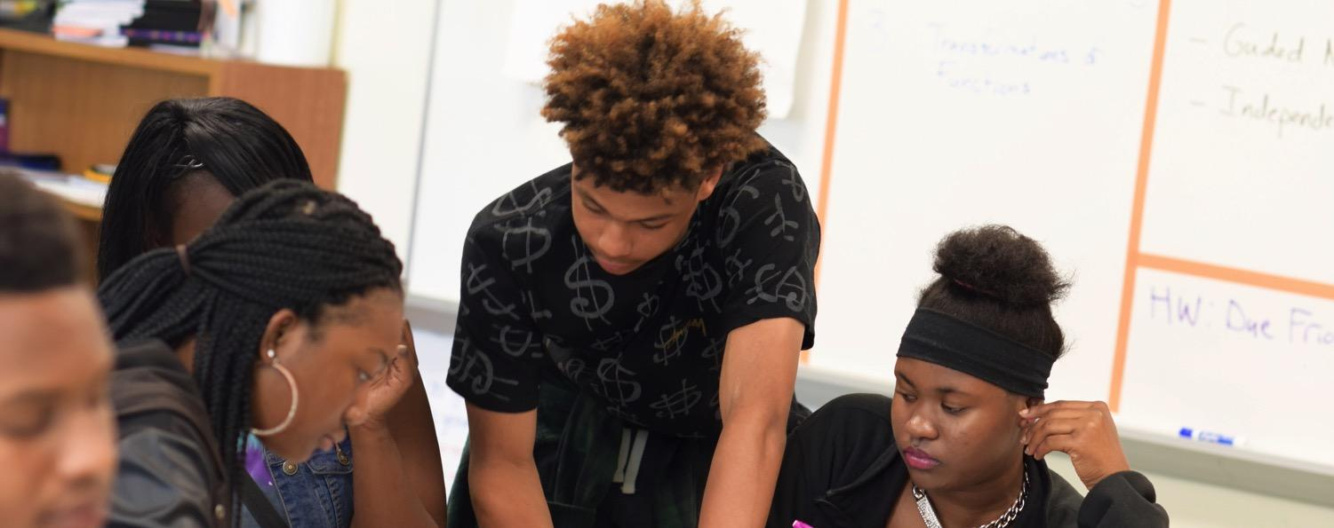
Community Builder
Our Racial Consciousness Partner A + B
Notes:
Facilitator Notes:
- Partner A has 15 seconds to think about the question “How might a teacher’s racial consciousness influence teaching and learning?”
- Partner A shares with Partner B for 45 seconds. Partner B only listens.
Partner B has 15 seconds to think about what Partner A has said.
Partner B takes 15 seconds to paraphrase what Partner A has said.
“I can’t understand the student’s racial predicament until I have become aware of my own racial predicament and the racial lens through which I look at the student.” -Glenn Singleton

Slide 7
The House We Live In:
Race – The Power of an Illusion
Notes:
Facilitator Notes: Visit this link and watch this video with your group: https://fod.infobase.com/OnDemandEmbed.aspx?Token=49736&aid=18596&Plt=FOD&loid=0&w=640&h=480&ref
If time allows, consider using this resource as additional support: http://www.pbs.org/race/000_General/000_00-Home.htm

Slide 8

Video Reflection
• What are terms, constructs, and concepts that we should honor when talking about race?
• How do you feel about what you’ve seen and heard? What information, insights, or questions do you have?
• How has race been used to justify social inequalities as natural? How is this manifested in our work? How is race not recognized in our work?
Notes:
Facilitator Notes: In quads, have the group meet to talk about the following questions above. Have the whole group share-out at the end of the conversation.

Slide 9
Unpacking the Pre-Work
After reading Tatum and watching the video, what context did the video provide for Tatum’s article?
Tatum
The House We Live In
Notes:
Facilitator Notes: Ask the group to determine what they learned in each resource and what common themes they found in both of them.

Slide 10
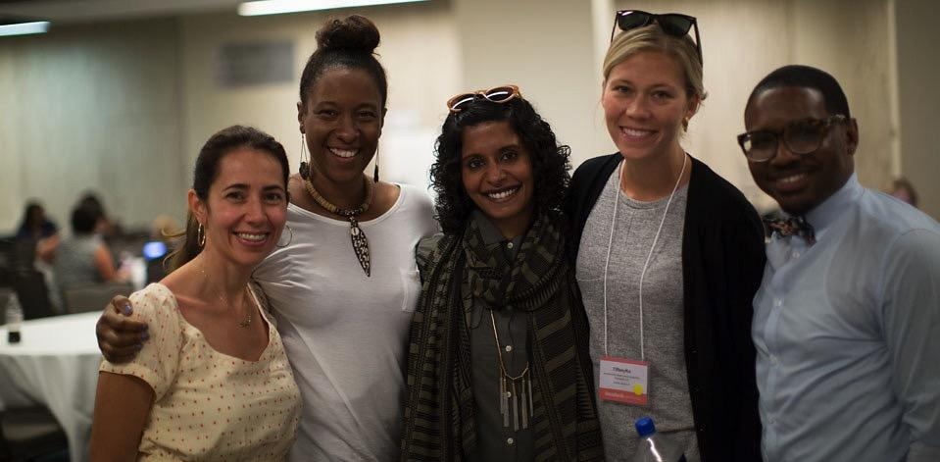
Bring it Home
Notes:
Facilitator Notes: Talk with your group about how the common themes found in Tatum’s article and The House We Live In are also found in your school.

Slide 11
What historical implications of race have influenced our school culture?
How do those historical implications of race appear in our school today?
?
Notes:
Facilitator Notes: Spend time as a team thinking about what historical implications of race have influenced your school culture. What cultural expectations do you have that support, negate, or counteract the community’s perception of ourselves? Brainstorm and share.
Some examples might include:
- Housing lines
- Income
- Graduation rates
- Matriculation rates
- Efficacy image

Slide 12


A Look at What’s Next
Introducing Bias
Understanding Historical Perspective about Race in America
How Bias Manifests in our School
Notes:
Facilitator Notes: Looking ahead at the next session

Slide 13
Thank You
Notes:
Facilitator Notes: Thank all of the participants for being open and vulnerable during the discussion today.

