Slide 1
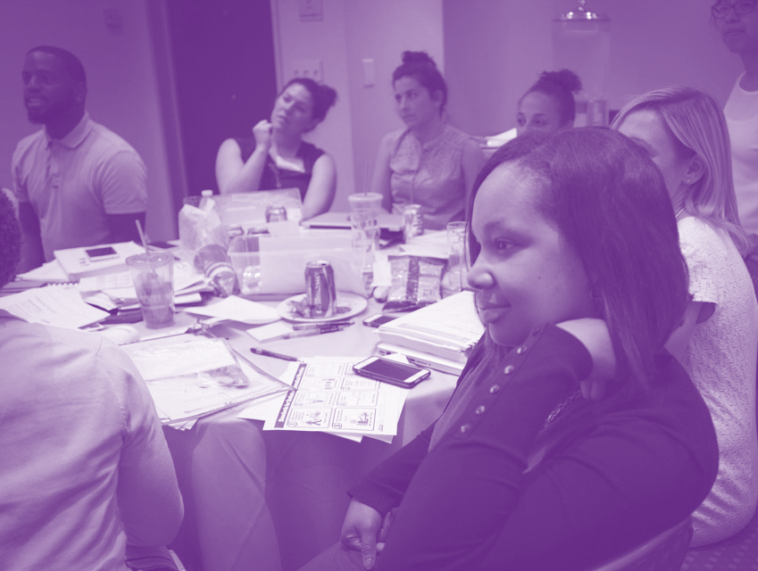
Session 1:
Introducing Bias
Except where otherwise indicated, all content is © 2016 UnboundEd Learning, Inc. www.unbounded.org
Notes:
PLEASE NOTE: This seven-step framework is adapted from © Case Studies on Diversity and Social Justice Education by Paul C. Gorski and Seema G. Pothini, 2018.

Slide 2
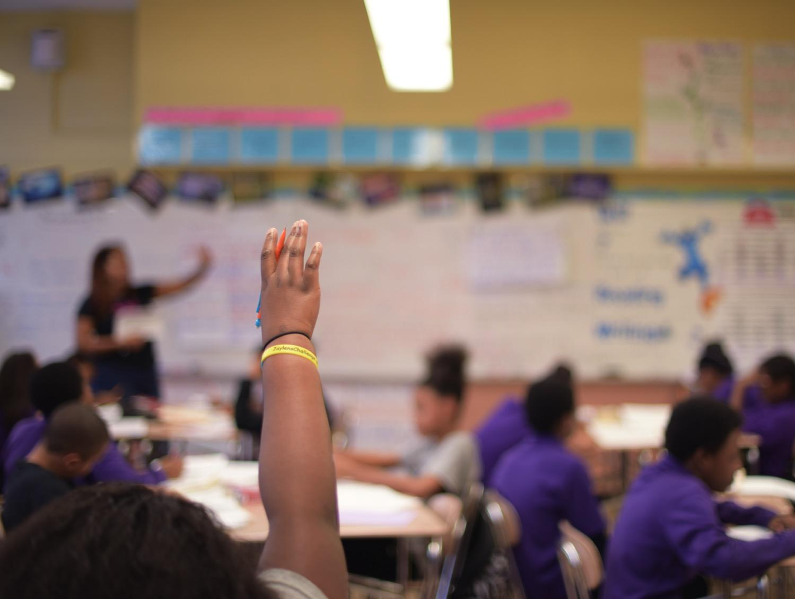
Group Norms for Our Discussion
Be willing to surface and explore unconscious beliefs and values.
Listen to hear, not respond.
Be mindful that your truth can be different for others.
Honor confidentiality.
Take responsibility for your own learning.
Be willing to think about situations and issues with a new or expanded perspective.
Notes:
Facilitator Notes: It is very important to carefully set up this conversation and have group norms that the group creates or agrees to. Here are some suggested norms.

Slide 3
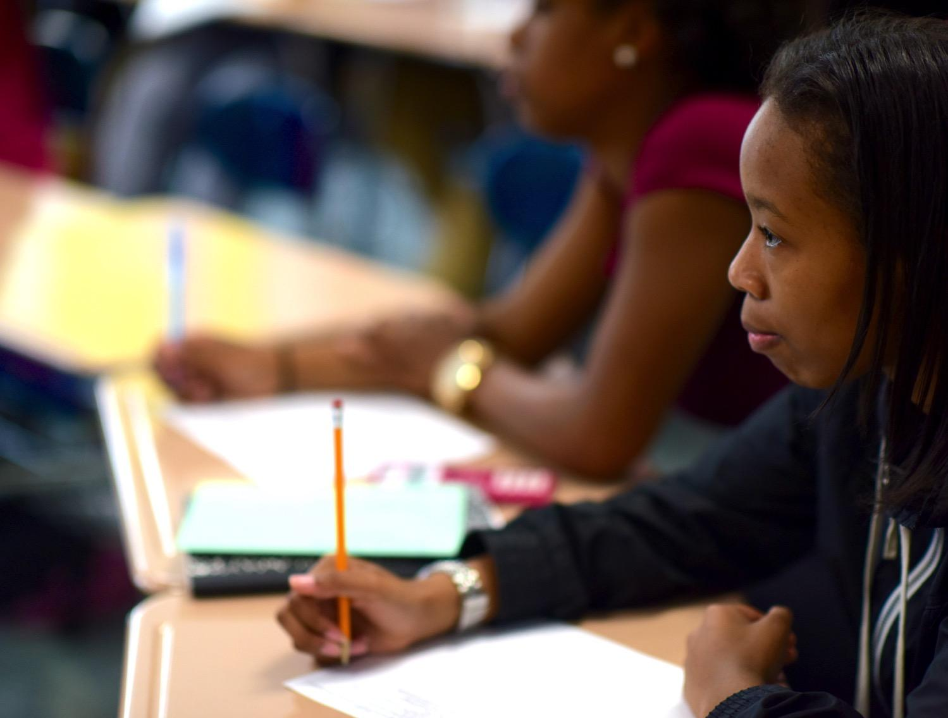
Set the Context
TBD
Notes:
Facilitator Notes: This slide is set aside for you to annotate the bias conversation. It is helpful to include any relevant data or notes that you have about your school. This is simply a framing slide and should require no more than 5 mins.

Slide 4
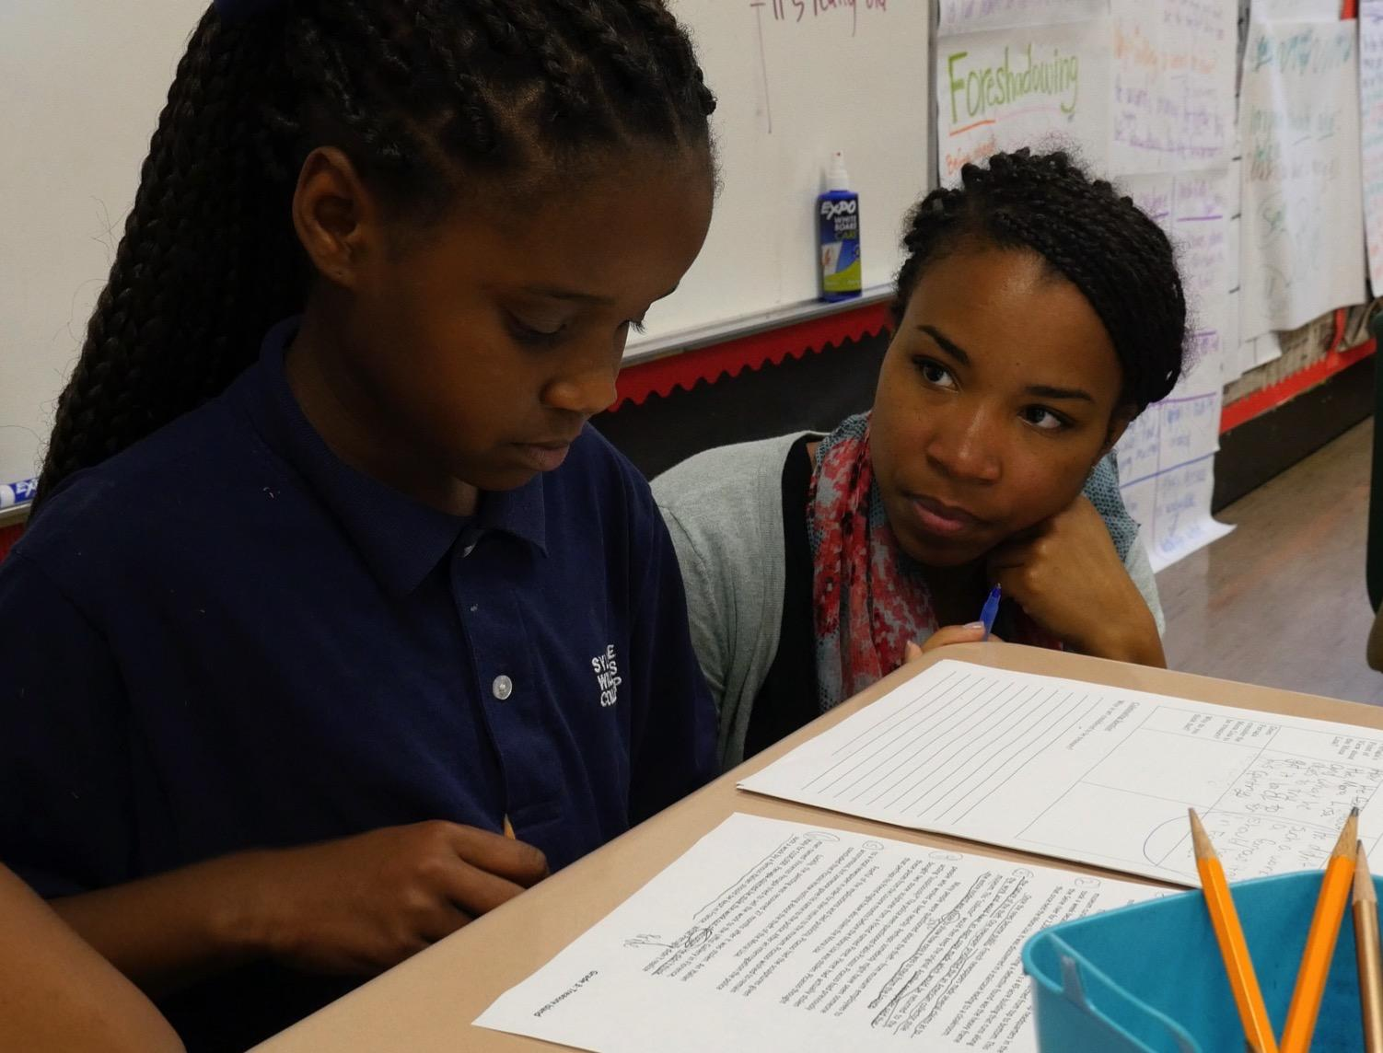
Case Study
After reading the case study, we’ll work through the following protocol to examine it.
Step 1) Identify the problem or problems posed by the case study
Step 2) Take stock of the different perspectives
Step 3) Consider possible barriers and opportunities
Step 4) Imagine equitable outcomes
Step 5) Brainstorm a short list of immediate-term responses
Step 6) Brainstorm long-term policy and practice adjustments
Step 7) Propose your plan of action
Notes:
Facilitator Notes:

Slide 5
Being Inside
Being Outside
Notes:
Facilitator Notes: There are a few options for running this activity.
You can split the room into two parts; creating pairs that face one another. Ask the left side of room to be partner A and right side of the room to be Partner B. Partner A will answer questions on slide 6 and then Partner B will answer. For slide 7, Partner A will answer questions on slide 6 and then Partner B will answer. Ask the pair to debrief what they took away from the back and forth. You can also split the room into into triads and have each person share their answers, for a larger group.
The facilitator should debrief with the whole group, asking a few groups to share out what they took away/ what they learned about one another through this activity.

Slide 6
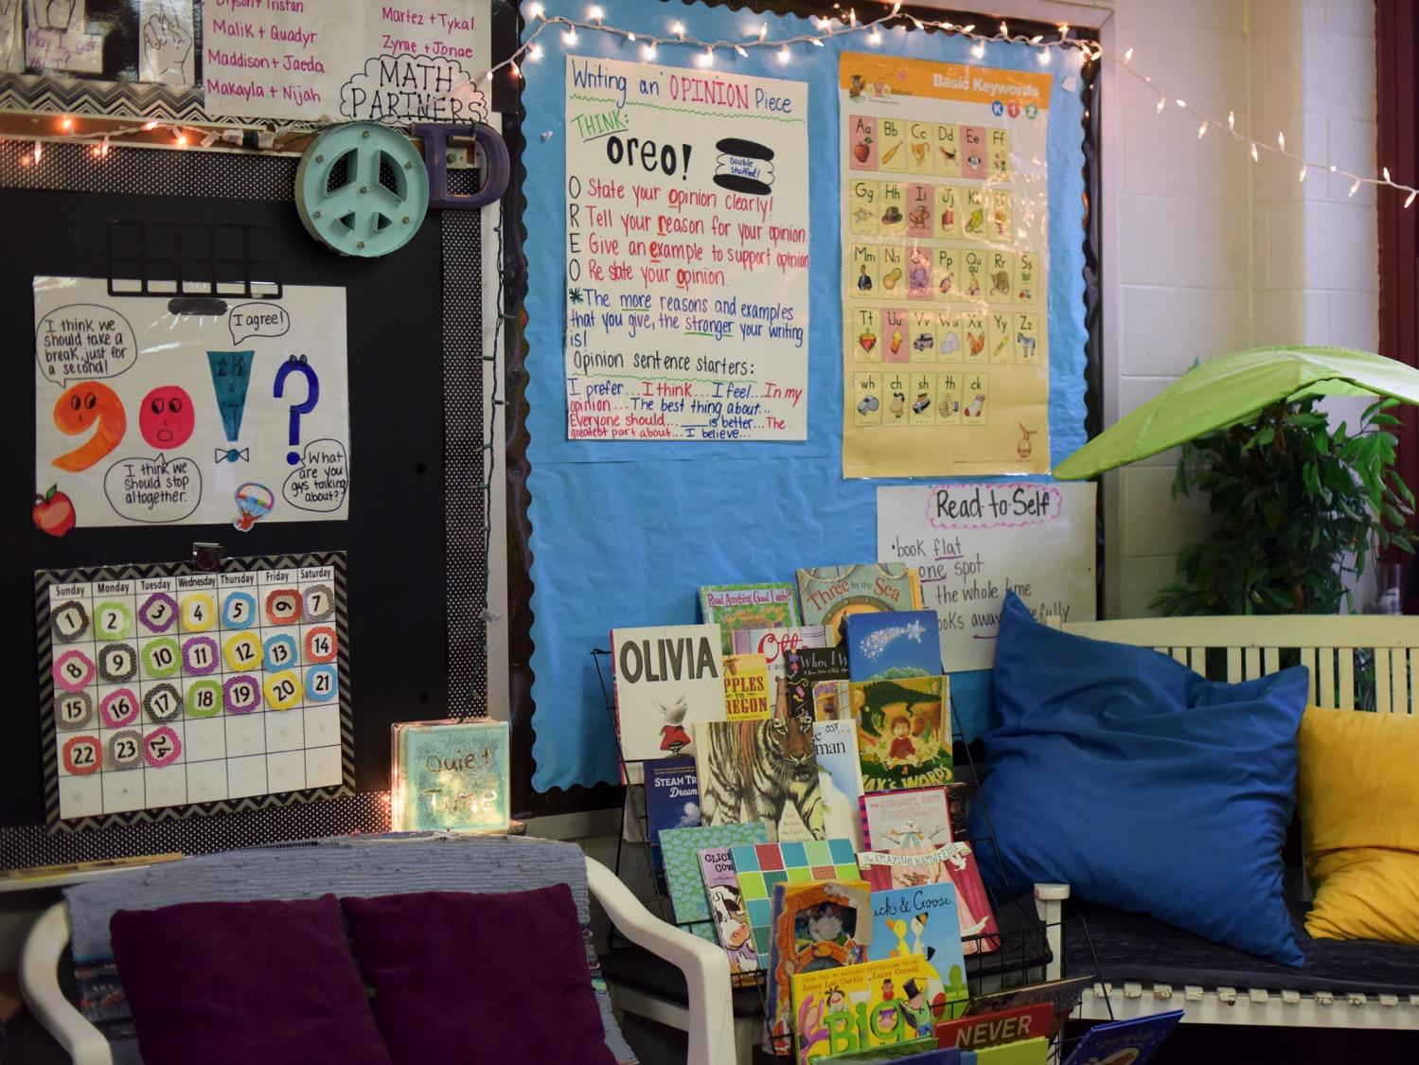
Being Inside
Think of a situation in which you are an “insider.” In this situation you feel accepted, respected, and feel you “belong.”
• Why do you feel like an insider in the situation you described?
• What advantages/privileges do you enjoy as an insider?
• Did you do anything to earn the advantages/privileges of being an insider? Please explain your response.
Notes:
Facilitator Notes: Continue on with the Inside/Outside activity by having the groups work through the these questions.

Slide 7
Being Outside
Think of a situation in which you are an “outsider.” In this situation you feel a lack of acceptance, respect, and feel you do not “belong.”
• Why do you feel like an outsider in the situation you described?
• What are the disadvantages of being an outsider?
• Did you do anything to deserve the disadvantages of being an outsider? Please explain your response.
Notes:
Facilitator Notes: Continue on with the Inside/Outside activity by having the groups work through the these questions.
Debrief with the whole group by asking a few groups to share what they took away or what they learned about one another through this activity.

Slide 8
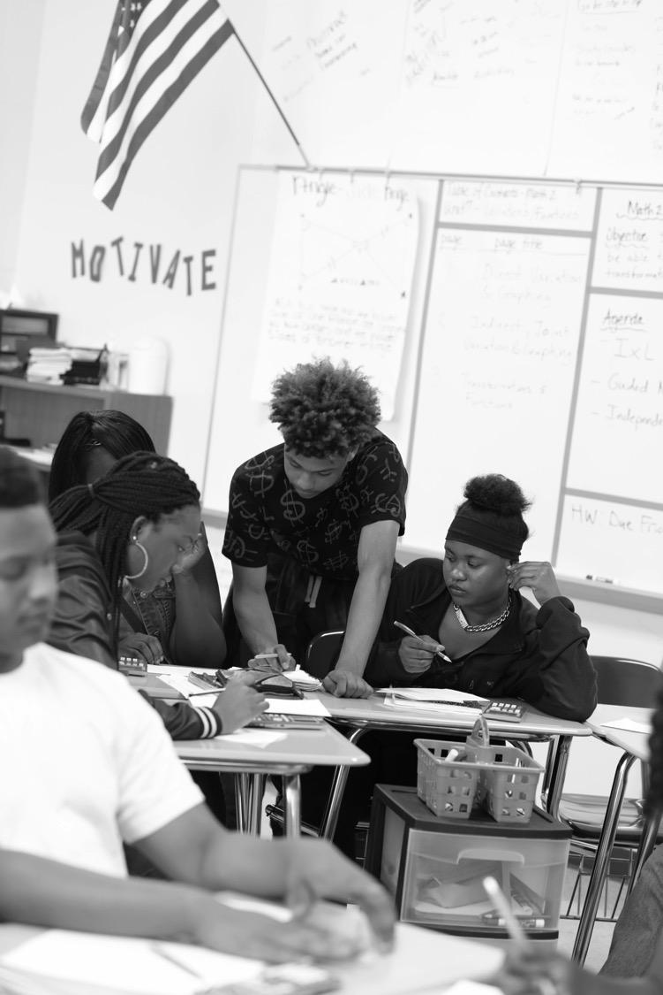
This activity is setting us up for a conversation about bias

Slide 9
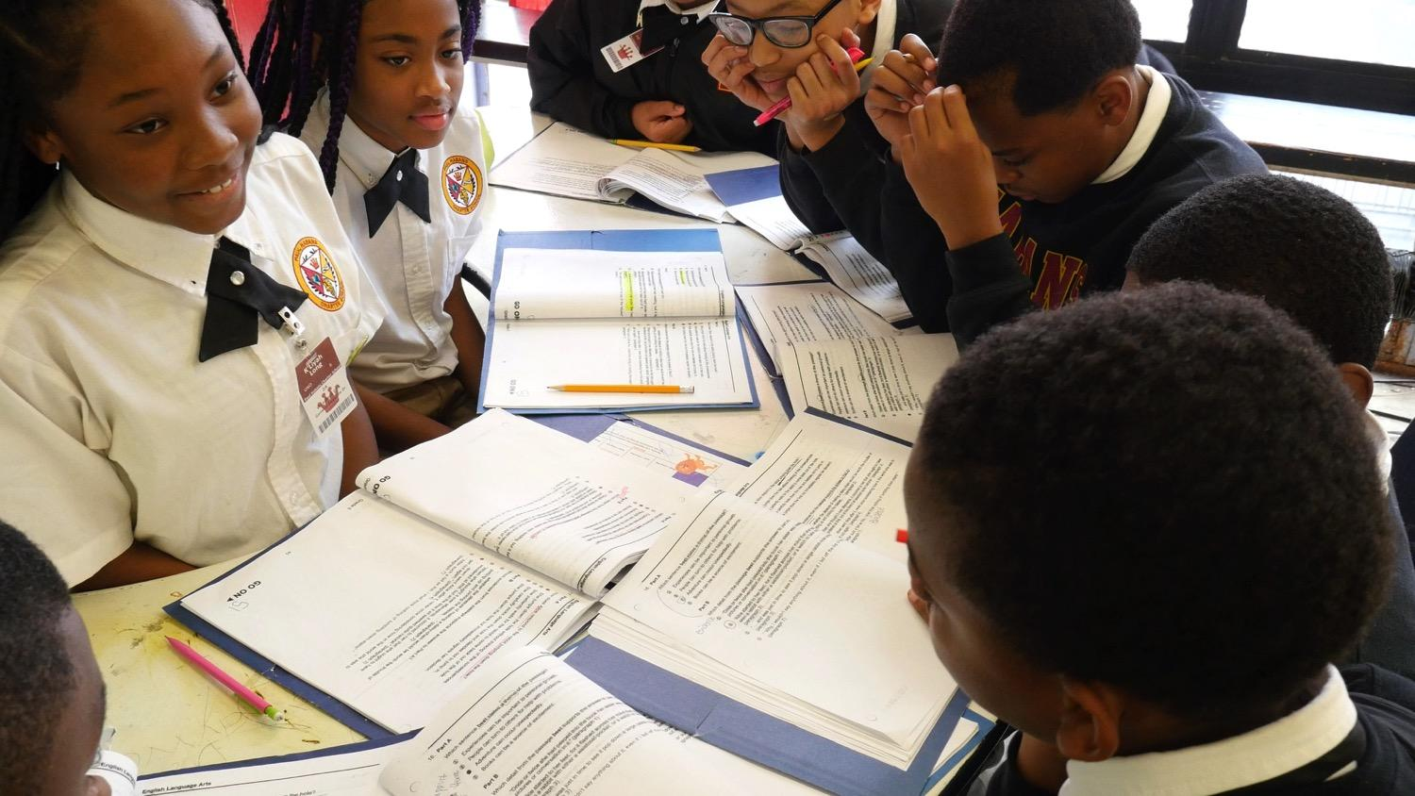
Questions We’re Going to Discuss
What is Unconscious Bias?
How does Unconscious Bias manifest in our world?
How can we recognize it and begin taking action?

Slide 10
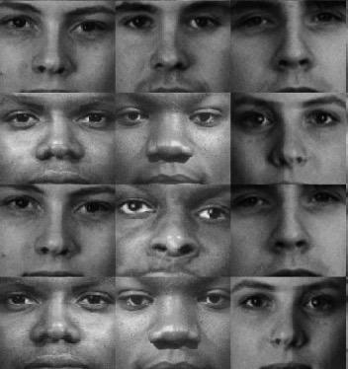
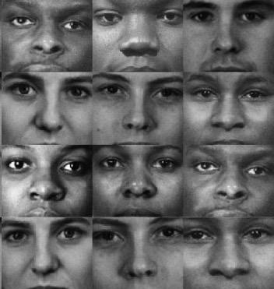
Unconscious Bias
refers to the automatic and unconscious stereotypes that drive people to behave and make decisions in certain ways. It is the mind’s way of making uncontrolled and automatic associations between two concepts very quickly.
Notes:
Facilitator Notes: This is the definition of Unconscious Bias. Be sure to read it out to the group and give them a moment to reflect on it. It is important to note that well-intentioned people may also hold implicit biases that run counter to their stated values.

Slide 11
How does bias manifest outside education?

Slide 12
The Legal Sector Exhibits Bias
A research memo from a hypothetical third-year litigation associate was sent to 60 partners from 22 different law firms.
“Caucasian” Thomas Meyer:
“generally good writer but needs to work on…”
“has potential”
“good analytical skills”
“African American” Thomas Meyer:
“needs lots of work”
“can’t believe he went to NYU”
“average at best”
Source: Reeves (2014).
Notes:
Facilitator Notes: At various times throughout these slides, please ask people in the room to reflect and react. Ask the group “What is your initial reaction?” You can have people to jot down their answers and then ask a couple of people share.
Research Notes:
In a recent study, Partners at a number of law firms scored the same memo far differently when told that the author was white or black.
The researchers drafted a research memo from a hypothetical third year litigation associate. Deliberately inserted 22 different errors.
Distributed to 60 different partners from 22 different law firms of whom 23 were women, 37 were men, 21 were racial/ethnic minorities, and 39 were Caucasian.
While all of the partners received the same memo, half the partners received a memo that stated the associate was African American while the other half received a memo that stated the associate was Caucasian.
On a five point scale, reviews for the exact same memo averaged a 3.2 for the “African American” author and 4.1 for the “Caucasian” author.
Overall the memo presumed to have been written by a “Caucasian” was "evaluated to be better in regards to the analysis of facts and had substantively fewer critical comments.
Partners found more spelling and grammar errors, more technical writing errors, and more errors in facts in the “African American” Thomas Meyer’s memo.
Source: Reeves (2014). Written in Black & White: Exploring Confirmation bias in Racialized Perceptions of Writing Skills. http://www.nextions.com/wp-content/files_mf/14468226472014040114WritteninBlackandWhiteYPS.pdf

Slide 13
The Sharing Economy Exhibits Bias
20 Airbnb accounts inquired about the availability of roughly 6,400 listings on Airbnb across five cities.
Guests with “African-American” names were 16% less likely to be accepted compared to guests with “White” names.
Source: Edelman, Luca, and Svirsky. (2016).
Notes:
Facilitator Notes: At various times throughout these slides, please ask people in the room to reflect and react. Ask the group “What is your initial reaction?” You can have people to jot down their answers and then ask a couple of people share.
Research Notes:
In a recent field experiment:
Researchers created twenty Airbnb accounts. These accounts were identical in all respects except for guest names: ten were distinctively African-American and ten were distinctively White names, divided into five male and five female names within each group. Airbnb profiles did not include a picture of the putative guest.
Inquired about the availability of roughly 6,400 listings on Airbnb across five cities.
Widespread discrimination against guests with distinctively African-American names. African-American guests received a positive response roughly 42% of the time, compared to roughly 50% for White guests.
Both African-American and White hosts discriminate against African-American guests; both male and female hosts discriminate; both male and female African-American guests are discriminated against.
Estimated that a host incurs a cost of roughly $65-$100 in foregone revenue by rejecting an African-American guest.
Source: Edelman, Luca, and Svirsky. (2016). Racial Discrimination in the Sharing Economy: Evidence from a Field Experiment. http://www.benedelman.org/publications/airbnb-guest-discrimination-2016-09-16.pdf

Slide 14
The Health and Human Services Sector Exhibits Bias
Even with the same credentials, a Black researcher’s chances of winning a National Institute of Health grant is 10 percentage points lower than a White researcher’s chances.
Source: Ginther et.al. (2011).
Notes:
Facilitator Notes: At various times throughout these slides, please ask people in the room to reflect and react. Ask the group “What is your initial reaction?” You can have people to jot down their answers and then ask a couple of people share.
Research Notes:
Analysis of grant data from the National Institute of Health (NIH), black scientists — and not other types of minorities — are less likely to receive government funding for a research project, even when they have the same credentials as their white peers. A black researcher’s chances of winning an NIH grant is 10 percentage points lower than a white researcher’s chances.
Source:
Ginther et.al. (2011). Race, Ethnicity, and NIH Research Awards. http://science.sciencemag.org/content/333/6045/1015.full

Slide 15
How does bias show up in education?
Notes:
Facilitator Notes: We used data sets outside the education world to show what bias is and how it can manifest in other sectors. Now it is time to look at how it can manifest in education.

Slide 16
Some examples of ways unconscious bias can reveal itself in school
Disproportionality in discipline
Disproportionality in special education designation
Disproportionality in lower performing “tracks”
Teacher mindsets, beliefs, behaviors: “orientation”
Dominant discourse re “smart” “bright” “slow” students
Notes:
Facilitator Notes: Do any of these examples play out in our school? Gather the current disciplinary data, special education data, tracking data, etc.
Question to consider: Ask your audience on a scale of 1-10 (1 = non existent and 10 = consistent with every member of the school community). Remind your audience that the definition of efficacy is

Slide 17
Disproportionality in discipline
132 preschool educators watched a video of preschoolers and asked:
Who would require most of your attention?
42% said: the Black boy
13% said: the White girl
No challenging behaviors were actually observed.
Source: Gilliam et.al (2016).
Notes:
Facilitator Notes: After explaining this study, ask the group “What is your initial reaction?” You can have people to jot down their answers and then ask a couple of people share.
Research Notes:
Is it possible that teachers’ implicit sex and race biases may impact their behavioral expectations, leading them to expect and anticipate more challenging behaviors from some children and therefore pay more attention to those children and scrutinize them more closely?
132 Participants (recruited at a large conference of early educators)
Task 1, participants viewed a series of video clips lasting 6 minutes. They were told the study is how teachers detect challenging behavior in the classroom. None of the videos contained challenging behavior.
Following the administration of the video clips, participants were shown a screen with photos of the four children they had previously seen in the balanced clips (a Black boy, a Black girl, a White boy, and a White girl). When expecting challenging behaviors teachers gazed longer at Black children, especially Black boys. 42% indicated that the Black boy required the most of their attention, followed by 34% (White boy), 13% (White girl), and 10% (Black girl)
Task 2, participants read a standardized vignette of a preschooler with challenging behavior and were randomized to receive the vignette with the child’s name implying either a Black boy, Black girl, White boy, or White girl, (Latoya, Emily, DeShawn, Jake)
Participants rated White children’s behavior as more severe than Black children’s. White teachers appear to hold Black preschoolers to a lower behavioral standard.
Source: Gilliam et.al (2016). Do Early Educators’ Implicit Biases Regarding Sex and Race Relate to Behavior Expectations and Recommendations of Preschool Expulsions and Suspensions? http://ziglercenter.yale.edu/publications/Preschool%20Implicit%20Bias%20Policy%20Brief_final_9_26_276766_5379.pdf

Slide 18
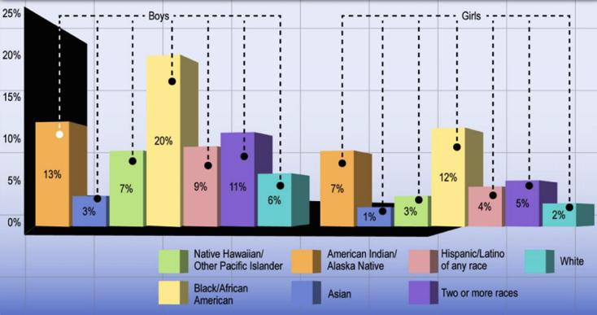
Disproportionality in discipline
Black boys and girls have higher suspension rates than any other group of students.
Suspension is a leading indicator for dropping out and future incarceration.
Percentage of students receiving suspensions, by race and gender, 2011-12
Source: Civil Rights Project. (2012).
Notes:
Facilitator Notes: This is simply more data to share with your group
Research Notes:
More than 3 million students are suspended each year, which is more than the total number of seats in all major league baseball and football stadiums in the country combined. Such high number of suspension is alarming because besides losing instructional time, suspension is one of the leading indicators of whether a student will drop out of high school or become incarcerated in the future.
Source: Civil Rights Project. (2012). http://civilrightsproject.ucla.edu/resources/projects/center-for-civil-rights-remedies/school-to-prison-folder/federal-reports/upcoming-ccrr-research/losen-gillespie-opportunity-suspended-summary-2012.pdf

Slide 19
Who Believes in Me?
White and other non-black teachers were 12% more likely than black teachers to predict black students wouldn't finish high school.
Non-black teachers were 5% more likely to predict their black male students wouldn't graduate high school than their black female students.
Black female teachers are 20% less likely than white teachers to predict their student wouldn't graduate high school, and 30% less likely to say that than were black male teachers.
White male teachers are 20% more likely to have low expectations for black female students.
Source: Gershenson, Holt, and Papageorge (2015).
Notes:
Facilitator Notes: This is simply more data to share with your group
Research Notes:
“Who Believes in Me” Study: In 16,000+ student-teacher dyads, two teachers reported their educational expectations for each 10th grade student.
A white teacher was about 30 percent less likely than a Black teacher to predict the same student will complete a four-year college degree.
Non-Black teachers were 12 percentage points more likely than Black teachers to predict black students wouldn't finish high school.
Black female teachers were 20 percent less likely than white teachers to predict their student wouldn't graduate high school.
White male teachers are about 10–20 percentage points more likely to have low expectations for black female students.
Source: Gershenson, Holt, and Papageorge. (2015). "Who Believes in Me? The Effect of Student-Teacher Demographic Match on Teacher Expectations." Upjohn Institute Work- http://research.upjohn.org/cgi/viewcontent.cgi?article=1248&context=up_workingpapers

Slide 20
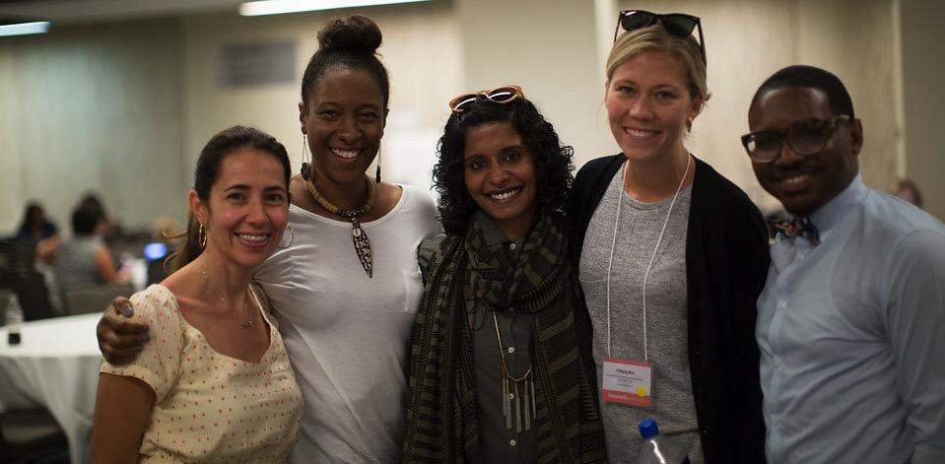
So What Does This Have to do With Us?

Slide 21
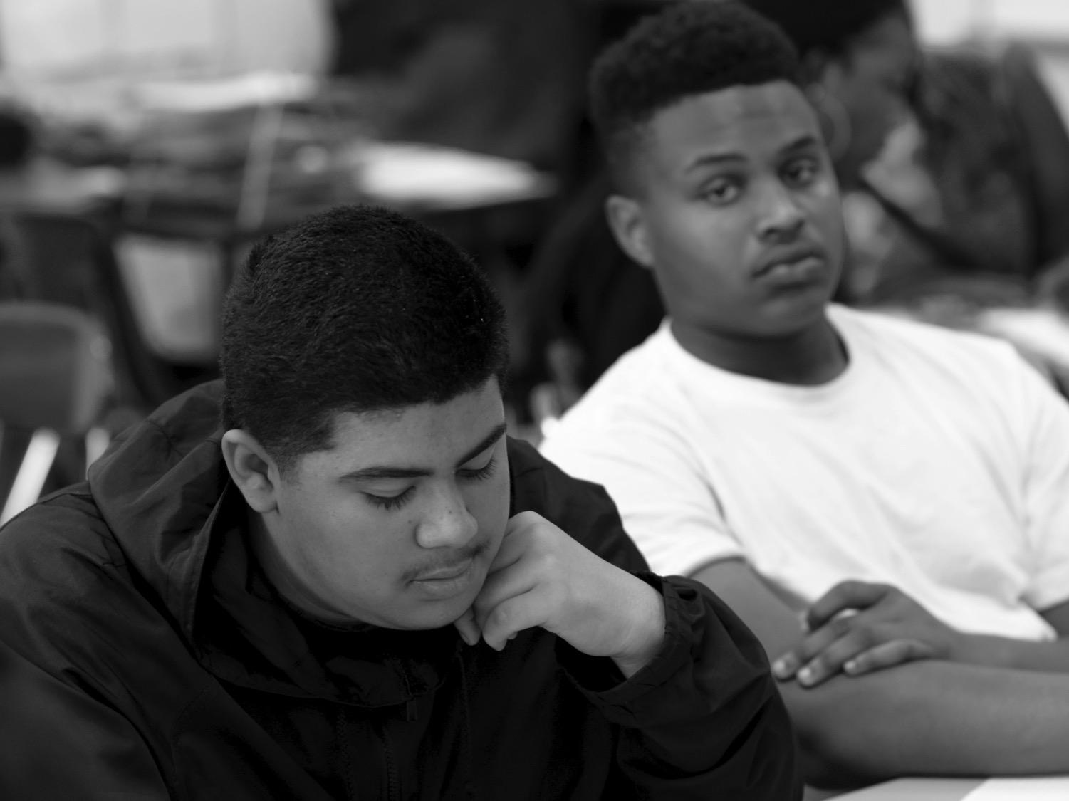
Bias Lives in All of Us
The ability to distinguish friend from foe helped early humans survive, and the ability to quickly and automatically categorize people is a fundamental quality of the human mind. Categories give order to life, and every day, we group other people into categories based on social and other characteristics.
This is the foundation of stereotypes, prejudice, and, ultimately, discrimination.
Source: http://www.tolerance.org/Hidden-bias
Notes:
Facilitator Notes: Explain that there once was an important reason for us to rely on our unconscious biases.

Slide 22
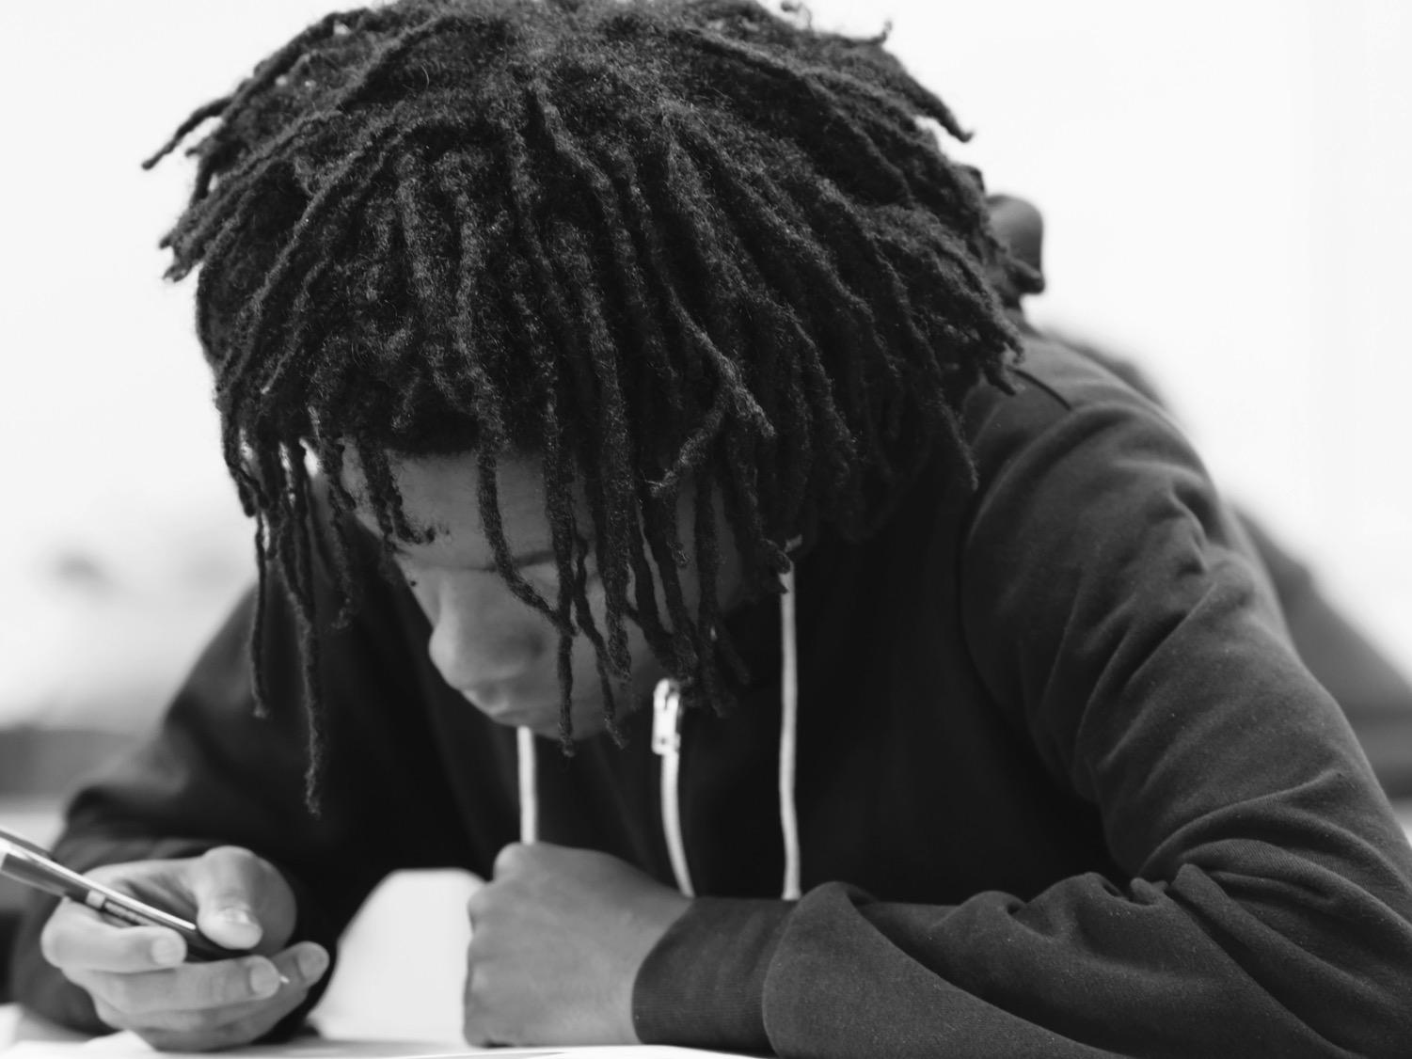
How do we Learn Prejudice?
Social scientists believe children begin to acquire prejudices and stereotypes as toddlers. Many studies have shown that as early as age 3, children pick up terms of racial prejudice without really understanding their significance.
Soon, they begin to form attachments to their own group and develop negative attitudes about other racial or ethnic groups, or the “out-group”. Early in life, most children acquire a full set of biases that can be observed in verbal slurs, ethnic jokes, and acts of discrimination.
Source: http://www.tolerance.org/Hidden-bias
Notes:
Facilitator Notes: Explain that although unconscious bias was once a beneficial survival mechanism, it is no longer necessary and has serious repercussions in the modern world.

Slide 23
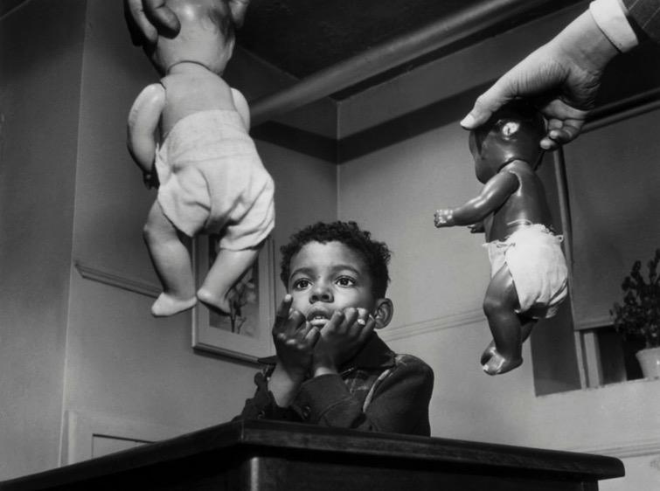
This activity is setting us up for a conversation about bias
Bias and Prejudice Are Learned at an Early Age
Notes:
Facilitator Notes: If you have time as a group, watch “A Girl Like Me” (start at 3:21 – 4:56) to show how bias can be developed at an early age.
The video can be found here: https://youtu.be/YWyI77Yh1Gg?t=3m21s

Slide 24
How Are Biases Reinforced?
Once learned, stereotypes and prejudices resist change, even when evidence fails to support them or points to the contrary.
People will embrace anecdotes that reinforce their biases, but disregard experience that contradicts them. The statement “Some of my best friends are ______” captures this tendency to allow some expectations without changing our bias.
Source: http://www.tolerance.org/Hidden-bias

Slide 25
Unpacking the Bias Test Results
Were you surprised by the results?
What did you experience or feel by taking
the test?
Now that you’ve gotten your results, what might be the next steps?
Notes:
Facilitator Notes: In triads, ask groups to unpack their findings from the bias test that they took before this session by thinking about the questions in the slide. One member from each group can share out the overarching takeaways from their group.

Slide 26
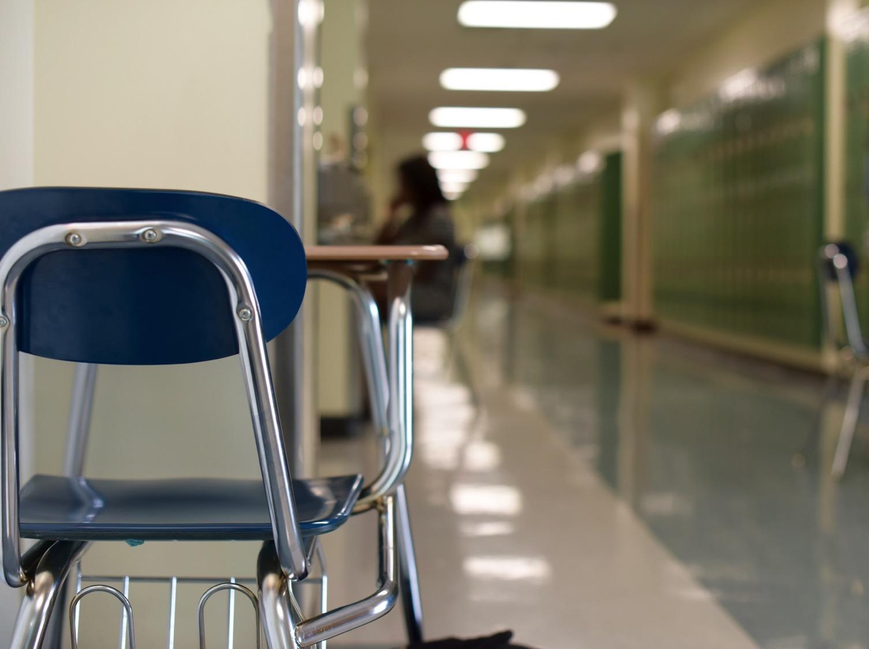
In order to achieve education equity, we must address our own biases.

Slide 27
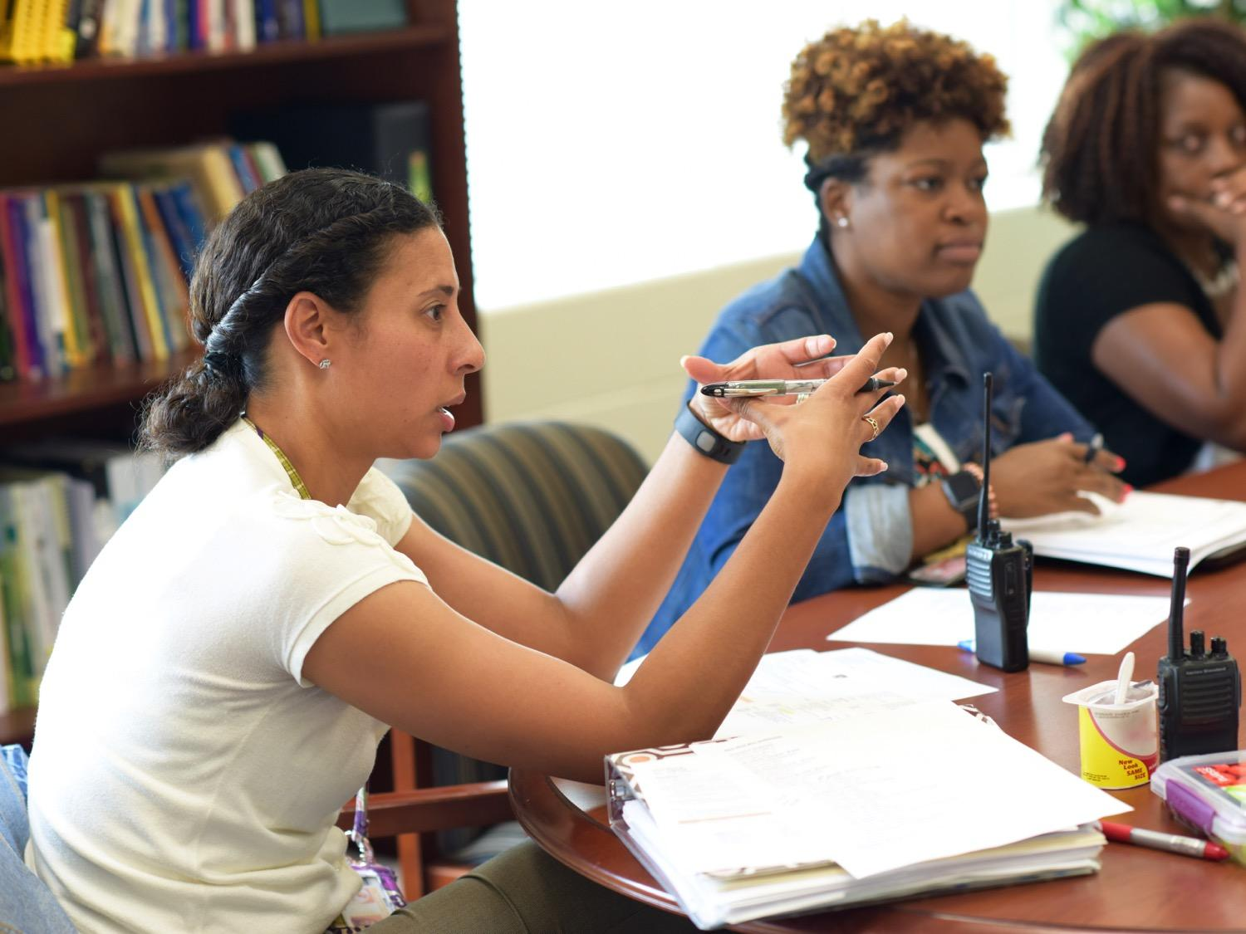
Reflections
What are your general reactions and takeaways from our conversation today? What did you learn that you didn’t expect?
Thinking back to the Inside/Outside activity, write a brief reflection on where biases or the impact of biases may have played out with you or with students you support in your educational career. Be ready to share during the next session.
Notes:
Facilitator Notes: Unpack the group’s reactions and takeaways from the conversation. Ask participants to take some time at home to reflect on the Inside/Outside activity and write down their thoughts for the next session.
Here are some additional questions:
1. What does our data show us about bias?
2. What are some ways we can begin screening our thoughts/actions and catch ourselves when we begin acting on UB?
3. What are some ways we can begin implementing a support system around UB amongst the adults within the school?
4. What are some different ways we can begin extending this conversation and dive deeper?
We did not include this as a slide, but you can also do a “plus” and “could be better if” about what worked during the meeting and what could be improved for the next one.

Slide 28
A Look at What’s Next
Introducing Bias
Understanding Historical Perspective about Race in America
How Bias Manifests in our School
Notes:
Facilitator Notes: Looking ahead at the next session

Slide 29
Thank You
Notes:
Facilitator Notes: Thank all of the participants for being open and vulnerable during the discussion today.

